Slide 1
Tic Tac Toe Full Stack Web Web Development Project Project
Learn about the power of full stack web development through building a Tic Tac Toe game using HTML, CSS, JavaScript, Express.js, and Socket.io.

Slide 2

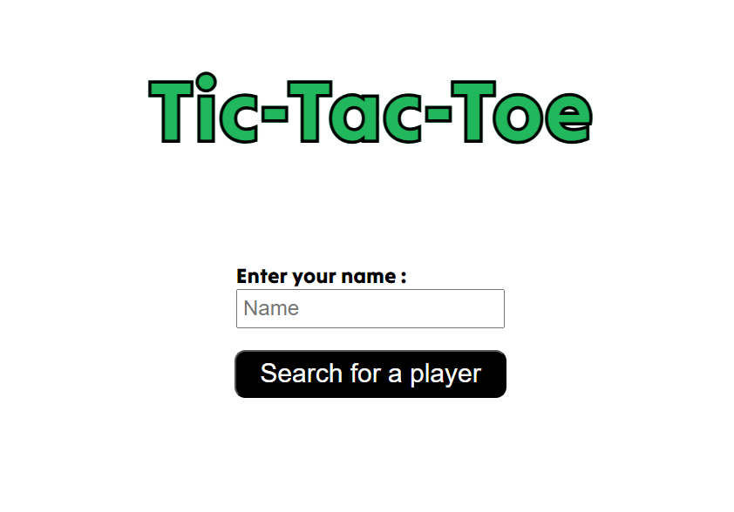
Introduction
1
Tic Tac Toe
Tic Tac Toe is a simple but classic game
that's easy to play and understand.
2
Full Stack Web Development
Full stack web development is the art of designing and implementing complete web applications that use frontend, backend, and database components.

Slide 3

Project Overview
Description
Our Tic Tac Toe project is a full stack web development application that lets users play Tic Tac Toe against each other in real time.
Tools Used
We used HTML, CSS, JavaScript, Express.js, and Socket.io to build the application.

Slide 4

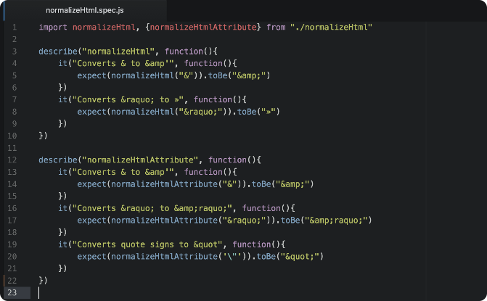
Frontend Development
Design and Layout
Implementation
We used HTML and CSS to design and layout the user interface for the Tic Tac Toe game.
We used JavaScript to build the game functionality, including game setup, turns, and win/loss conditions.

Slide 5


Backend Development
1
Server Creation
We used Express.js to create the server side of the application and manage the client requests.
Real-Time Communication
2
We used Socket.io to enable real-time communication between clients and
server.

Slide 6
Conclusion
1
Summary
2
Key Takeaways
We built a Tic Tac Toe game using full stack web development tools, including HTML, CSS, JavaScript, Express.js, and Socket.io.
Our development process taught us about the power and versatility of full stack web development and the value of real-time communication using Socket.io.

